Slide 1

Scale to Zero and Live Migration of Stateful Apps on Kubernetes
Felicitas Pojtinger
Head of R&D
@pojntfx
{∞} Loophole Labs

Slide 2
What is Checkpoint/Restore?

Slide 3
CPU registers
Devices
Memory contents
File descriptors

Slide 4
Topics
Usecases for C/R
How C/R is implemented in Linux
Using C/R in Kubernetes with Architect

Slide 5
Scale to Zero

Slide 6





Slide 7
Regional websites
Varying demand
Fan out architecture

Slide 8
Checkpoint → Cluster usage goes down
Cluster usage goes down → Nodes released to AWS
Restore → Cluster usage goes up
Cluster usage goes up → Nodes requested from AWS

Slide 9
Live Migrations

Slide 10
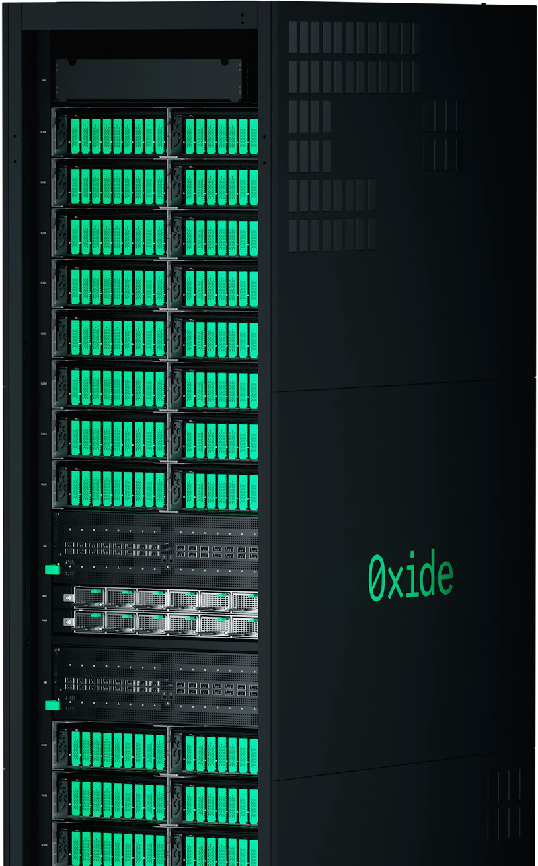
Moving between nodes →
App has to restart → downtime

Slide 11
Live migration between nodes →
App state persists →
No downtime!

Slide 12
1. Live migrate to other node
2. Perform maintenance on node
3. Live migrate back to node

Slide 13



Slide 14
Checkpoint/Restore in Userspace
Kernel interfaces to dump and restore kernel resources
Mainlined kernel patches

Slide 15
CRIU Checkpoint
Seizes all threads in the target process tree
Injects code snippets into target process ("infection")
Reads `/proc/pid/maps` to find out what memory the process allocates
Dumps memory contents from `/proc/pid/mem` etc. to disk, along with permissions, flags etc.
Goes through all file descriptors (files, sockets, pipes and special files) and dumps positions, flags, paths, connection state, buffers etc. to disk
Dumps namespace memberships (PID, network, mount, user etc.), CPU register state etc. to disk
Reads kernel state from `/proc` and `/sys` on the process and dumps it into the file
After checkpointing, process is either left running or killed

Slide 16
CRIU Restore
Recreates the process tree as a skeleton with fork
Locks and sets `/proc/sys/kernel/ns_last_pod` to desired `PID - 1` to restore processes with the original PID)
Recreates or joins namespaces that were like they were before the checkpoint
Reopens files at original paths, recreates pipes, sockets and TCP connections
Restores in-flight data in pipes and buffers by manipulating kernel state
Remaps memory regions (and mmap'ed files) at the original addresses, then fills memory from the memory images
Restores CPU registers including the instruction pointer
Restores credentials, signal handlers etc.
Unpauses the restored process by jumping into the restored instruction pointer

Slide 17
No runtime overhead
Checkpoints are (somewhat) portable
Can fail for complex/arbitrary applications

Slide 18


Slide 19
Great security properties
Virtualization of syscalls, FS and networking

Slide 20
gVisor Process Start
Reads the OCI runtime spec (`config.json`) just like any other OCI runtime would
Creates a new process for the sandbox and puts it into a network namespace, configures resources with cgroups
Starts gofer process (a filesystem process) with very limited capabilities (no `CAP_SYS_ADMIN` etc.)
Starts Sentry (the sandbox component) in the sandbox process we've started earlier
Sets up a gVisor kernel (task scheduler, signal handlers, VFS etc.)
Mounts emulated filesystems via the gofer (e.g. /proc, /sys and so on)
Sets up netstack (Go implementation of the kernel's network stack in userspace)
Sets up Linux seccomp filters on the sandbox (Sentry)
Loads the container's binary (PID 1) and sets up memory mappings, the stack, interpreter etc.
Creates an init task in the kernel (with memory, file descriptors, FS context, credentials and signal handlers)
Unblocks init task on startup

Slide 21
Syscalls → caught by KVM/systrap, then emulated in Sentry
FS I/O → caught by VFS, resolved via RPCs to Gofer
Network I/O → caught by netstack, written to AF_PACKET sockets

Slide 22
gVisor Checkpoint
Get a request via the sandbox control socket (sent by runsc checkpoint etc.) in the sandbox controller
Pauses all tasks by sending an internal SIGSTOP signal and waiting until all task goroutines have stopped
Stops all timers, waits for gofers and netstack to finish
Serialize gVisor kernel state like PIDs, CPU register states, credentials, IPC objects and namespaces
Serialize memory addresses and file descriptors, much like how CRIU does it, except using the virtualized resources, not the actual Linux kernel resources
Serialize filesystem state from the VFS, e.g. mount tables, host paths that correspond to the gofer paths
Serialize network state with netstack (TCP connection state, UNIX sockets etc.)
Serialize virtual device state (PTYs etc.)
Write into checkpoint image files based on protobuf schema
After checkpointing, process is either left running or killed & the sandbox torn down

Slide 23
No need for PID emulation
No “infection” code
TCP checkpoint/restore is easier

Slide 24
gVisor Restore
Sandbox process, Sentry and gofer get started just like with the initial start, with minimal state
Checkpoint image files get read into memory, where the state decode then parses the format and unmarshals into the relevant serializable gVisor components
Kernel state gets restored by iterating through tasks and creating goroutines for each, using the same internal PID as on checkpoint
CPU registers, signal handlers, credentials and FS context get set back in the gVisor resources
Memory managers get recreated in the same virtual address ranges as the checkpoint and memory pages get read from the checkpoint files
mmap-ed regions backed by an actual file get re-mapped to the same path on the host
File descriptor tables get restored for each task, by gofer re-opening them on the host or reading them from the checkpoint data for tmpfs
Network state gets restored by creating a new netstack instance and creating NICs and routing tables with the stored data from the checkpoint
TCP sockets, UNIX sockets etc. get restored in netstack
Devices (PTY etc.) get restored by recreating them based on the checkpoint data
To resume, the kernel clears the restore flag (similar to the stop flag)

Slide 25


Slide 26
Needs hardware acceleration or nested virt
Starts lightweight microVMs, not processes
Overhead because of nested guest kernel
KVM-based isolation
CPU templates make CPUID masking easy

Slide 27
microVM Startup
Receives a REST API call that configures the internal VM configuration
Opens /dev/kvm and creates a VM file descriptor via KVM_CREATE_VM
Allocates guest memory via mmap and registers the new memory regions via the KVM devices
Creates vCPUs for each CPU via the KVM devices
Loads the Linux kernel into guest memory
Initializes virtio devices (disks/block devices, net, entropy etc.) and registers them on the VM bus
Configures the system for boot (setting up ACPI (x86)/Device Tree (aarch)) and spawns a (paused) thread for each vCPU
Applies seccomp filters to the VMMs and vCPU threads for better sandboxing (similar to how the Sentry is sandboxed in gVisor), then unpauses the vCPU threads and KVM begins executing the guest kernel

Slide 28
Code → Runs on physical CPU, sandboxed via VT-d/VT-x
Device IO → virtio devices
Networking → TAP devices & netns

Slide 29
microVM Checkpoint
Receives a REST API call that pauses all vCPUs, which causes all vCPU threads to exit from KVM_RUN
Sends a SaveState event to each vCPU thread, which dumps CPU state (e.g. registers, MSRs, LAPIC state, TSC frequency, CPUID leaves etc.)
Dumps VM-level states (guest memory etc.) and virtio device state from the host (serializes queues and configuration, e.g. MAC address or TAP device names)
Serializes device state into a snapshot file and guest memory into a separate file
After checkpointing, VM is either left running (by resuming the vCPU threads) or stopped completely

Slide 30
Lazy-loading of memory
Firecracker controls the entire CPU and devices
No need for a VFS
No need for TCP restore
File descriptors, syscalls etc. are just memory

Slide 31
microVM Restore
Receives REST API call that opens the snapshot state file and deserializes it
Loads guest memory with mmap (so that it can be lazy-loaded), either from a file (for non-anonymous memory) or initialized with zeros
Reads vCPU counts, memory sizes, CPU templates etc. and configures KVM like at startup, just using the values from the checkpoint files
Restores vCPUs by setting TSC frequencies and registers for each vCPU from the checkpoint
Restores the Firecracker implementations of the virtio devices from the checkpoints by deserializing them, (re-)opening the TAP devices, setting the MAC addresses and recreates the queues
Like with the original startup process, it applies seccomp filters to the VMMs and vCPU threads for better sandboxing (similar to how the Sentry is sandboxed in gVisor), then unpauses the vCPU threads and KVM begins executing the guest kernel

Slide 32
PVM
Pagetable-based Virtual Machine

Slide 33
VMs need a KVM vendor implementation
Nested virt has high latency and security issues
Emulation is slow

Slide 34
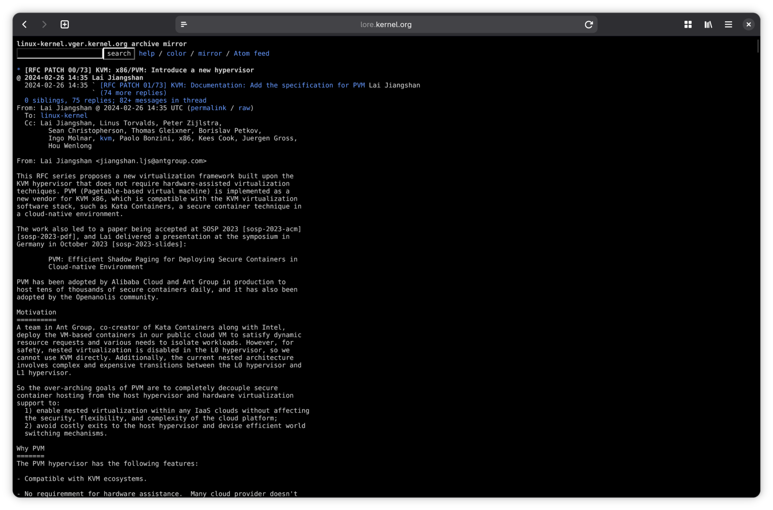


Slide 35
PVM Internals
Guest kernel runs in Ring 3 like userspace; guest/host separation enforced via software flags and shadow page tables
Guest syscalls trap to in-kernel switcher, which updates CR3 and GSBASE, then jumps directly to guest kernel handler via SYSRETQ (no hypervisor)
Guest hypercalls use SYSCALL in supervisor mode, trap to hypervisor for PVM-specific operations (page table switching, TLB, MSR) or standard KVM hypercalls
Shadow page tables map guest physical to host physical addresses; guest page table modifications intercepted and mirrored to shadow tables
Interrupts trap to hypervisor for handling (shadow MMU, emulation) or injection back to guest

Slide 36
Very performant for CPU-bound processes
Slow if page table is used heavily
Not mainlined yet

Slide 37


Slide 38
During migrations, networking usually breaks
XDP runs in driver mode, so lots of kernel steps can be skipped
XDP can be used for both egress and ingress

Slide 39
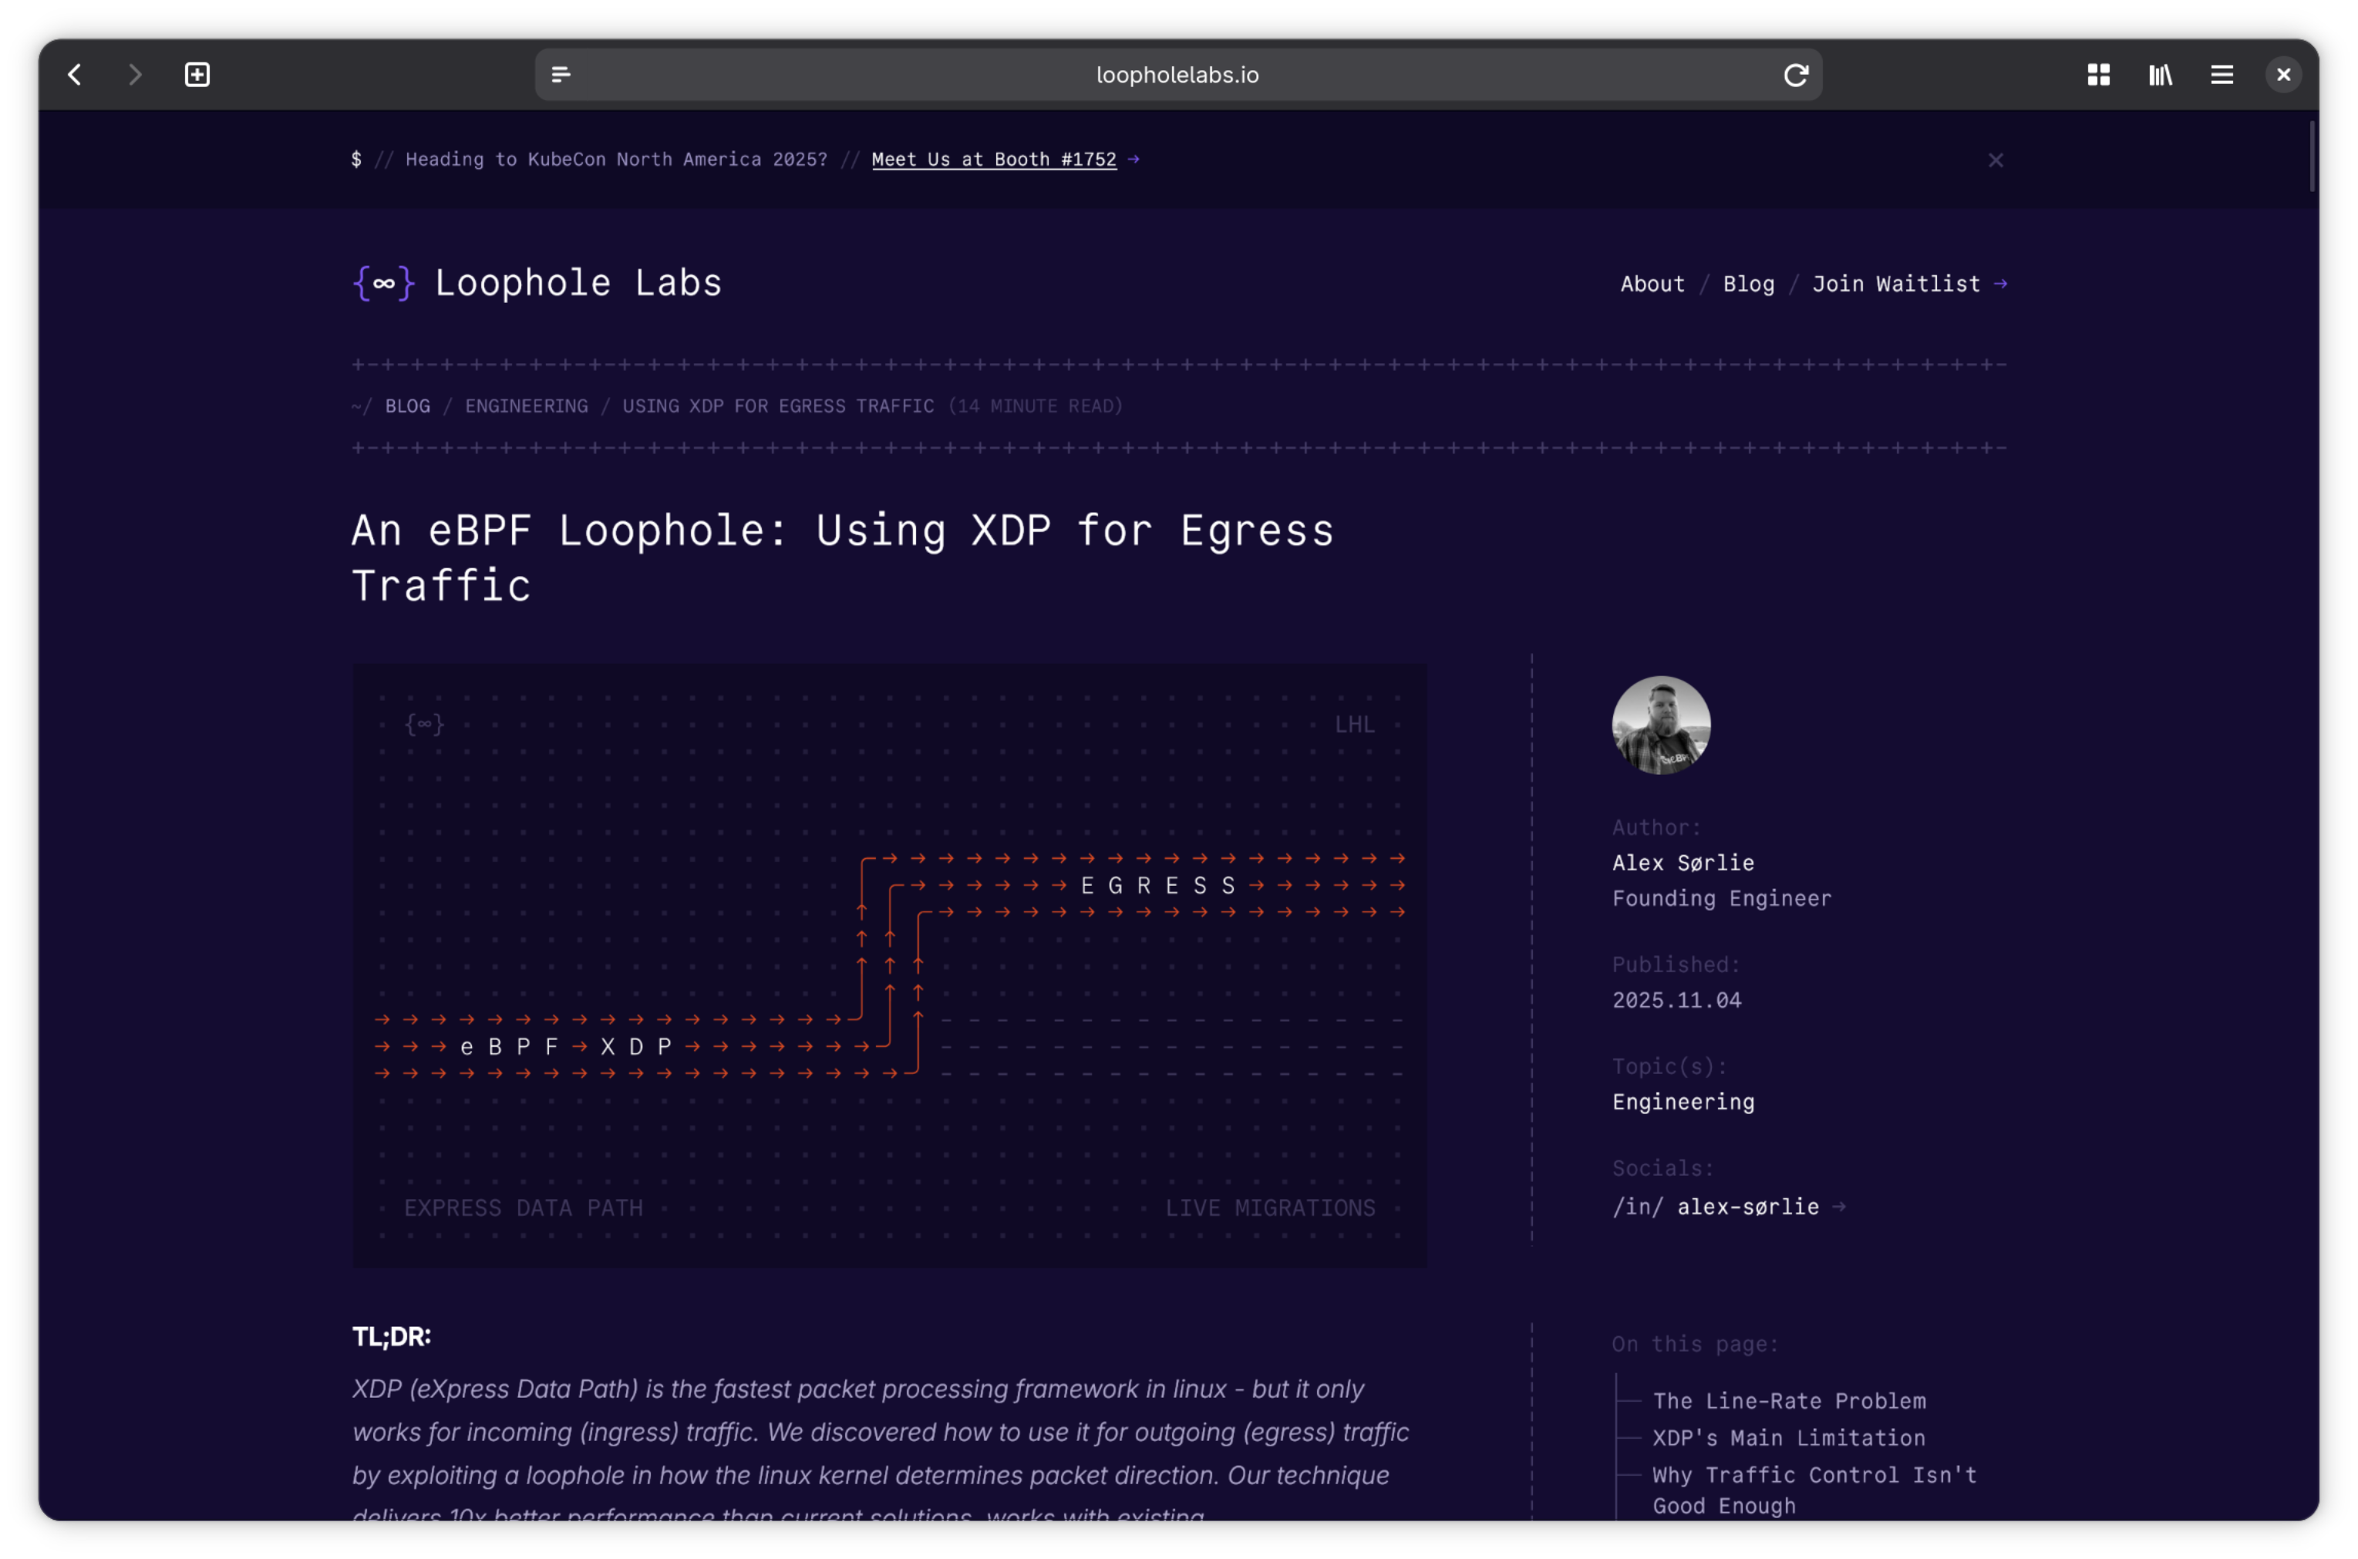


Slide 40
Network migration via eBPF XDP
Intercept traffic
Buffer/pause traffic before a checkpoint
Do a checkpoint
Restore from checkpoint on different (migration) or same (scale to zero) node
Flush buffers
Unpause connection

Slide 41
Demo
Checkpoint/Restore in Kubernetes with Architect

Slide 42
/~\ Architect

Slide 43
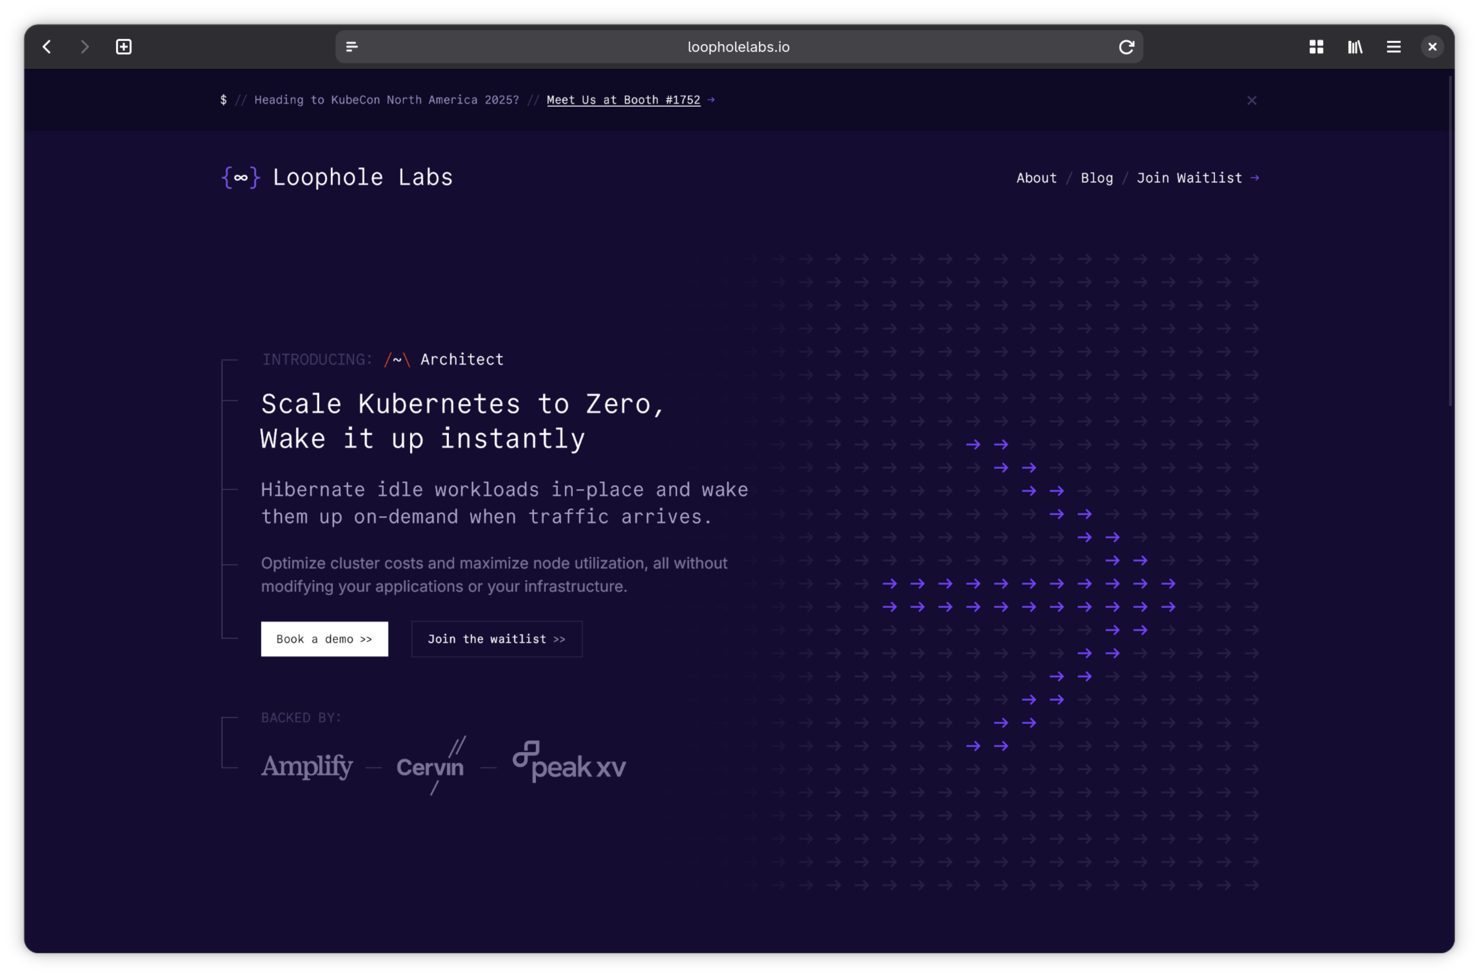


Felicitas
Pojtinger
Fediverse: @pojntfx@mastodon.social
Bluesky: @felicitas.pojtinger.com
GitHub: @pojntfx
LinkedIn: in/pojntfx
Web: https://felicitas.pojtinger.com/
{∞} Loophole Labs
← Waitlist
Slides & Links →

